Slide 1
Fundamentals of Probability
Qifu Tyler Sun

Slide 2
Probability mass function
Sample space. X = {x₁, …, x_{m}}
Definition. {p(x₁) … p(x_{m})} is a valid probability mass function (p.m.f) on r.v. X if
0 ≤ p(x_{i}) ≤ 1 for all i
∑_{<i>} p(x_{i}) = 1
Exampe 1. X = {1, 2, 3, 4, 5, 6}, p(x_{i}) = 1/6
Example 2. X = {0, 1, 2, …}, p(j) = p(1 – p)^{j}, where 0 ≤ p ≤ 1 is a parameter. // Geometric distribution

Slide 3
Exercise 1
Sample space: X = {0, 1}, Y = {a, b}, Z = {α, β}
Joint prob. mass function:
p(0, a, α) = 0.1, p(0, a, β) = 0.1, p(0, b, α) = 0.1, p(0, b, β) = 0.2 p(1, a, α) = 0.1, p(1, a, β) = 0.1, p(1, b, α) = 0.1, p(1, b, β) = 0.2
Calculate p(X = 0, Y = a), p(X = 0, Y = b), p(X = 1, Y = a), p(X = 1, Y = b);
Calculate p(X = 0), p(X = 1), p(Y = a), p(Y = b), p(Z = α), p(Z = β).
Notes:
X⊥Y, X⊥Z, Y not independent of Z

Slide 4
Exercise 1
Sample space: X = {0, 1}, Y = {a, b}, Z = {α, β}
Joint prob. mass function:
p(0, a, α) = 0.1, p(0, a, β) = 0.1, p(0, b, α) = 0.1, p(0, b, β) = 0.2 p(1, a, α) = 0.1, p(1, a, β) = 0.1, p(1, b, α) = 0.1, p(1, b, β) = 0.2
p(X = 0, Y = a) = p(0, a, α) + p(0, a, β) = 0.2,
p(X = 0, Y = b) = p(0, b, α) + p(0, b, β) = 0.3,
p(X = 1, Y = a) = 0.2, p(X = 1, Y = a) = 0.3.
p(X = 0) = p(0,a,α)+p(0,a,β)+p(0,b,α)+p(0,b,β) = .5
p(X = 1) = .5
p(Y = a) = .4, p(Y = b) = .6, p(Z = α) = .4, p(Z = β) = .6
Notes:
X⊥Y, X⊥Z, Y not independent of Z

Slide 5
Independence
Sample spaces:
X = {x₁, …, x_{m}}, Y = {y₁, …, y_{n}}
Definition. X is independent of Y (X⊥Y) if
P(X = x_{i}, Y = y_{j}) = P(X = x_{i})P(Y = y_{j})
// i.e. p(x_{i}, y_{j}) = p(x_{i})p(y_{j}) ∀ 1 ≤ i ≤ m, 1 ≤ j ≤ n
Ex. In Exercise 1, check whether X⊥Y, Y⊥Z, X⊥Z.

Slide 6
Exercise 2
Assume X = Y = {0, 1, 2}, p_{X} = {1/2, 1/4, 1/4}, p_{Y} = {1/3, 1/3, 1/3}, X⊥Y. Calculate Pr{X ≠ Y}.
Pr{X ≠ Y} = Pr{X = 0, Y≠ 0}+Pr{X = 1, Y≠ 1}+Pr{X = 2, Y≠ 0}
Notes:
X⊥Y, X⊥Z, Y not independent of Z

Slide 7
Mutual independence
Sample spaces:
X = {x₁, …, x_{m}}, Y = {y₁, …, y_{n}}, Z = {z₁, …, z_{s}}
Definition. X, Y, Z are mutually independent (X⊥Y⊥Z) if
P(X = x_{i}, Y = y_{j}, Z = z_{k}) = P(X = x_{i})P(Y = y_{j})P(Z = z_{k})
// i.e. p(x_{i}, y_{j}, z_{k}) = p(x_{i})p(y_{j})p(z_{k})
∀ 1 ≤ i ≤ m, 1 ≤ j ≤ n, 1 ≤ k ≤ s
Definition. X, Y, Z are pairwise independent if
X⊥Y, Y⊥Z, X⊥Z

Slide 8
Mutual and pairwise independence
Mutual independence ➔ Pairwise independence
(why?)
Pairwise independence =✗=> Mutual independence
(exercise)

Slide 9
Mutual and pairwise independent
“A implies B” is not equivalent to “B implies A”
“A implies B” ⬄ “not B implies not A” (Contrapositive)
Example.
Assume “Today is Sunday” implies “there is no class”.
Cannot say “since there is no class, today is Sunday”,
but we can say “since there is class, today is not Sunday”.

Slide 10
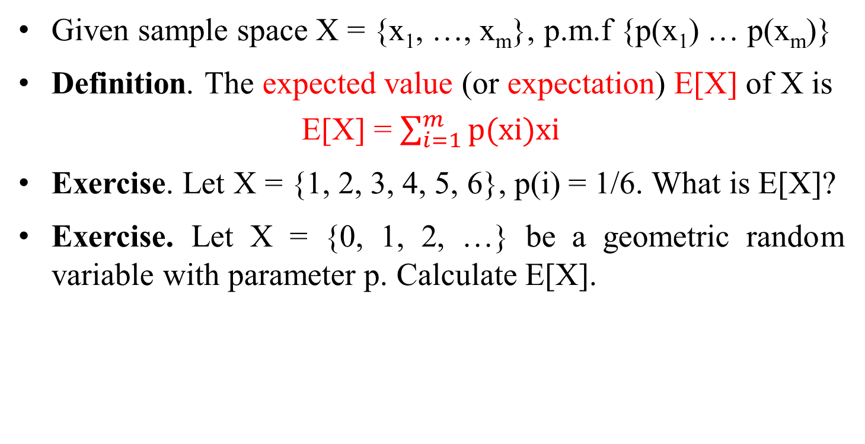
Expectation
Given sample space X = {x₁, …, x_{m}}, p.m.f {p(x₁) … p(x_{m})}
Definition. The expected value (or expectation) E[X] of X is
E[X] = $\sum_{i=1}^{m}{\text{p}\text{(}\text{xi}\text{)}\text{xi}}$
Exercise. Let X = {1, 2, 3, 4, 5, 6}, p(i) = 1/6. What is E[X]?
Exercise. Let X = {0, 1, 2, …} be a geometric random variable with parameter p. Calculate E[X].

Slide 11
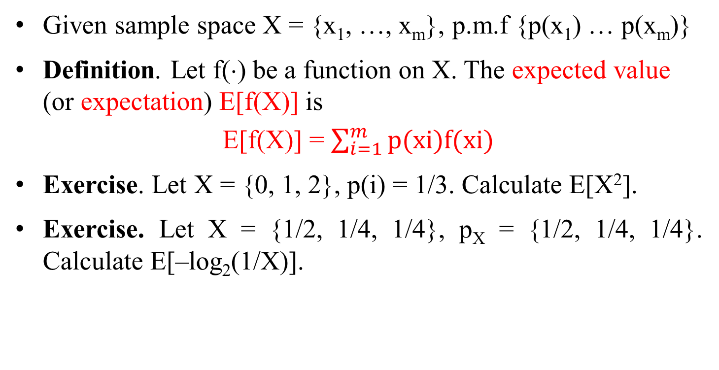
Expectation
Given sample space X = {x₁, …, x_{m}}, p.m.f {p(x₁) … p(x_{m})}
Definition. Let f(⋅) be a function on X. The expected value (or expectation) E[f(X)] is
E[f(X)] = $\sum_{i=1}^{m}{\text{p}\text{(}\text{xi}\text{)}\text{f}\text{(}\text{xi}\text{)}}$
Exercise. Let X = {0, 1, 2}, p(i) = 1/3. Calculate E[X²].
Exercise. Let X = {1/2, 1/4, 1/4}, p_{X} = {1/2, 1/4, 1/4}. Calculate E[–log₂(1/X)].

Slide 12
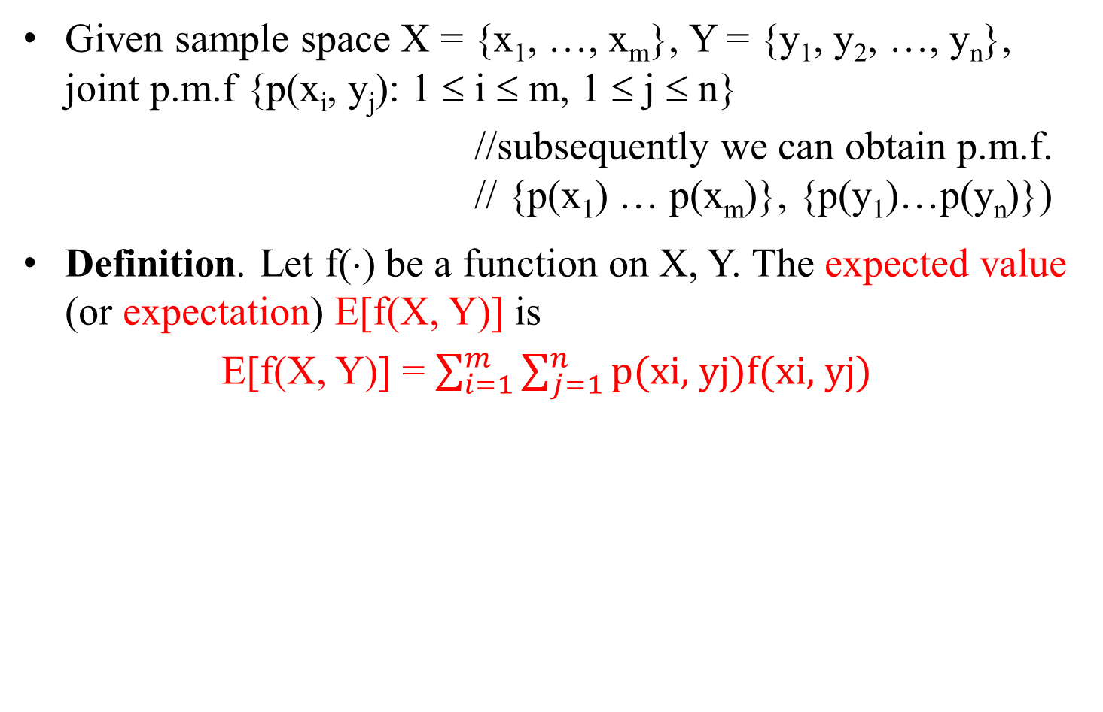
Expectation
Given sample space X = {x₁, …, x_{m}}, Y = {y₁, y₂, …, y_{n}}, joint p.m.f {p(x_{i}, y_{j}): 1 ≤ i ≤ m, 1 ≤ j ≤ n}
//subsequently we can obtain p.m.f. // {p(x₁) … p(x_{m})}, {p(y₁)…p(y_{n})})
Definition. Let f(⋅) be a function on X, Y. The expected value (or expectation) E[f(X, Y)] is
E[f(X, Y)] = $\sum_{i=1}^{m}{\sum_{j=1}^{n}{\text{p}\text{(}\text{xi}\text{, }\text{yj}\text{)}\text{f}\text{(}\text{xi}\text{, }\text{yj}\text{)}}}$

Slide 13
Expectation
Exercise. Let X = {0, 1, 2}, Y = {0, 1}, p{X = i} = 1/3, p{Y = j} = 1/2, X⊥Y. Calculate E[X+Y], E[XY].
Exercise. Let X = {0, 1}, Y = {0, 1}, p{X = 0, Y = 0} = 1/2, P{X = 1, Y = 1} = 1/4, P{X = 0, Y = 1} = P{X = 1, Y = 0} = 1/8. Calculate E[X+Y], E[XY].

Slide 14
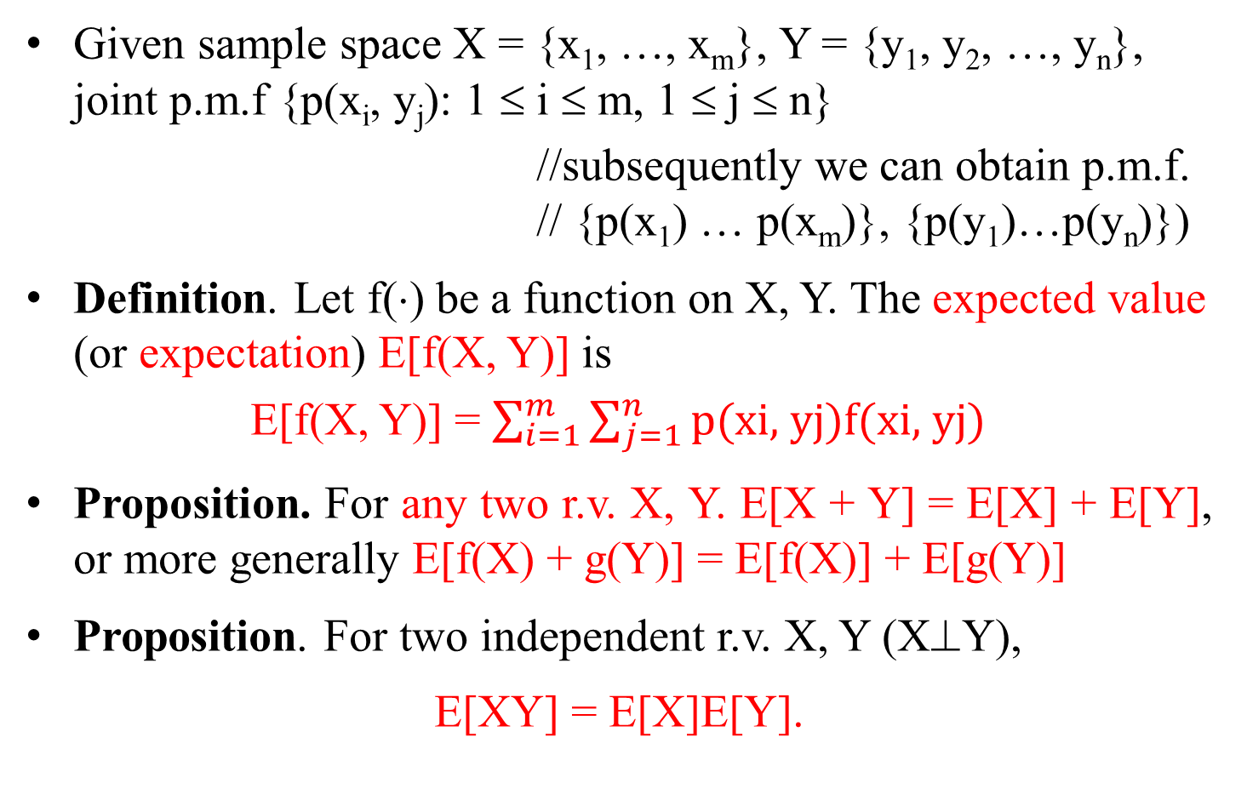
Expectation
Given sample space X = {x₁, …, x_{m}}, Y = {y₁, y₂, …, y_{n}}, joint p.m.f {p(x_{i}, y_{j}): 1 ≤ i ≤ m, 1 ≤ j ≤ n}
//subsequently we can obtain p.m.f. // {p(x₁) … p(x_{m})}, {p(y₁)…p(y_{n})})
Definition. Let f(⋅) be a function on X, Y. The expected value (or expectation) E[f(X, Y)] is
E[f(X, Y)] = $\sum_{i=1}^{m}{\sum_{j=1}^{n}{\text{p}\text{(}\text{xi}\text{, }\text{yj}\text{)}\text{f}\text{(}\text{xi}\text{, }\text{yj}\text{)}}}$
Proposition. For any two r.v. X, Y. E[X + Y] = E[X] + E[Y], or more generally E[f(X) + g(Y)] = E[f(X)] + E[g(Y)]
Proposition. For two independent r.v. X, Y (X⊥Y),
E[XY] = E[X]E[Y].

Slide 15
Conditional Probability
X = {x₁, … x_{m}}, Y = {y₁, …, y_{n}}
Definition. P(Y = y_{j} | X = x_{i}) = P(X = x_{i}, Y = y_{j}) / P(X = x_{i})
// Interpretation: given that event x_{i} occurs for r.v. X, the probability that event y_{j} occurs for r.v. Y.
Prop. When X⊥Y, P(Y = y_{j} | X = x_{i}) = P(Y = y_{j}) ∀i, j
Prop. When Y = f(X),
P(Y = y_{j} | X = x_{i}) = 1, if y_{j} = f(x_{i});
P(Y = y_{j} | X = x_{i}) = 0, if y_{j} ≠ f(x_{i})
Ex. Calculate Pr{X = 0 | Y = a}, Pr{X = 1 | Y = b}, Pr{X = 1 | Z = α} in Ex. 1.

Slide 16

Conditional Probability
X = {x₁, … x_{m}}, Y = {y₁, …, y_{n}}
Prop. P(X = x_{i}) = $\sum_{j=1}^{n}{\text{p}\text{(}\text{xi}\text{,}\text{yj}\text{)}}\text{= }\sum_{j=1}^{n}{\text{p}\text{(}\text{x}\text{i}\text{|}\text{yj}\text{)}\text{p}\text{(}\text{y}\text{j}\text{)}}$
Baye’s formula.

Slide 17
Conditional Probability
Example. An urn contains two type A coins and one type B coin. When a type A coin is flipped, it comes up heads with probability 1/4, whereas when a type B coin is flipped, it comes up heads with probability 3/4. A coin is randomly hosen from the urn and flipped. Given that the flip landed on heads, what is the probability that it was a type A coin?
Let Y = {H, T} be the r.v. for the side the coin landed on, and let X = {A, B} be the r.v. for the type of coin that is selected.
We need compute P(X = A | Y = H). (Answer is 2/5). P(X = A | Y = T) (answer is 6/7).

